Slide 1

Fueling the Future, Powering Progress
ABSTRACT ION
INTERFCES
BSCS-II
Sukkur IBA University Kandh Kot

Slide 2

SIBA K.KOT
What is Abstraction ?
Abstraction is the concept of hiding complex implementation details and showing only the essential features of an object.
Ex: Withdrawing money from ATM Machine without knowing how it is working from inside.

Slide 3


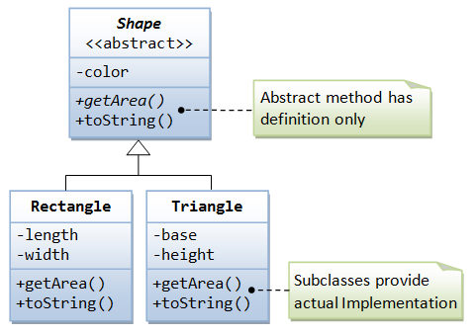
SIBA K.KOT
Diagram example for Abstraction

Slide 4

SIBA K.KOT
Programming Examples of Abstraction
abstract class ATM {
abstract void performTransaction();
}
class Withdraw extends ATM
{
voidperformTransaction()
{
System.out.println(" Cash Withdrawn...");
}}
public class Abstract{
public static void main(String[] args) {
Withdrawobj=newWithdraw(); obj.performTransaction();
}}

Slide 5

SIBA K.KOT
Properties of Abstraction
Cannot be Instantiated: You cannot create objects of abstract classes directly.
May contain abstract methods: Abstract classes have methods without implementation.
Provides a blueprint: Meant to be extended by subclasses that provide specific behavior.
Focuses on “what” not “how”: Emphasizes what an object does, not how it does it.
Supports partial implementation: Can contain both abstract and concrete methods, unlike interfaces.

Slide 6
Advantages of Abstraction
Hides internal implementation details.
Shows only essential features to the user.
Improves code maintainability and readability.
Reduces code complexity.
Enhances security by exposing only necessary parts.

Slide 7
SIBA K.KOT
What is an Interface
Interface in Java programming language is defined an abstract type which gives us 100% abstraction.
Interfaces take only the abstract method.

Slide 8
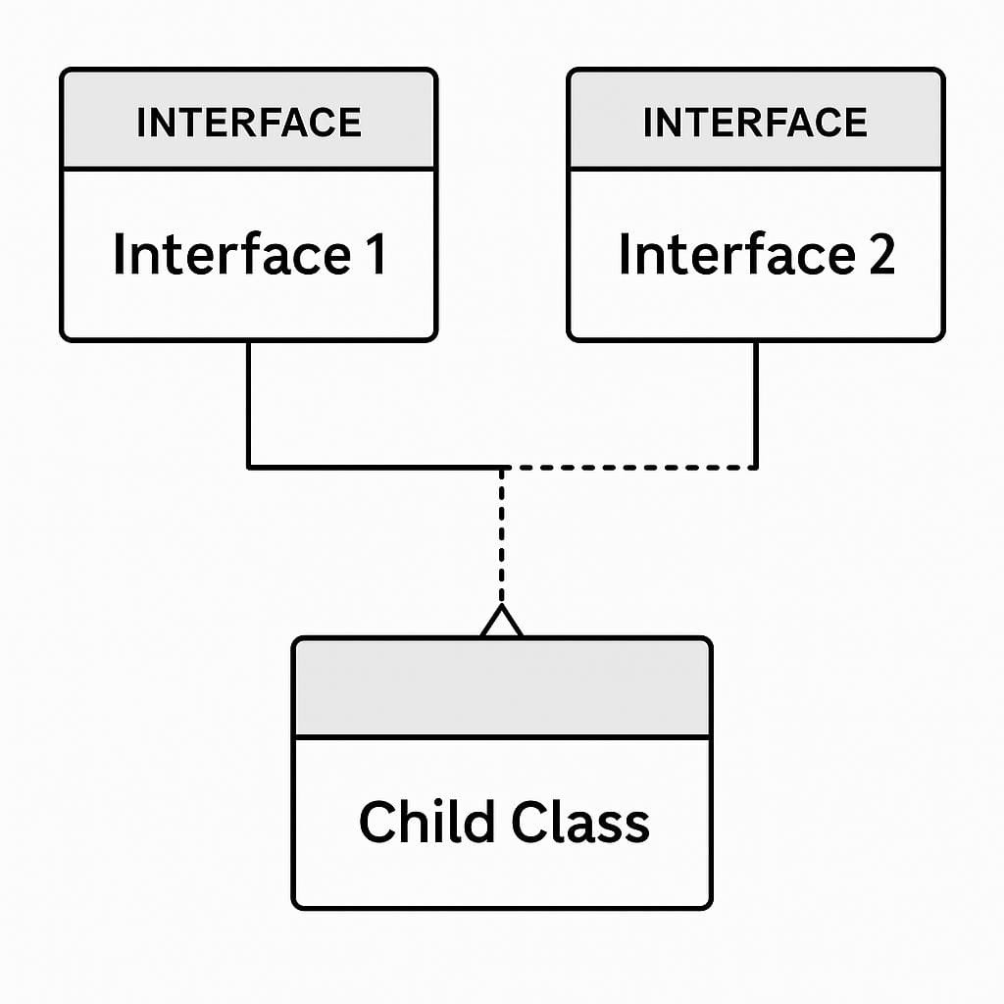
SIBA K.KOT
Diagram example for Interface
IMPLEMENTS

Slide 9
SIBA K.KOT
Programming Examples of Interface
interface Shape{
void area();
}
Class circle implements shape {
Public void area(){ System.out.println(“circle area 44cm”);
}
Class triangle implements shape{
Public void area(){ System.out.println(“triangle area 44cm”);
}

Slide 10
SIBA K.KOT
Properties of Interfaces
Contains abstract methods.
Use implements keyword to implement an interface.
Supports multiple inheritance.
All methods are public and abstract by default.
Interfaces can extend other interfaces.

Slide 11
SIBA K.KOT
Thank you for your attention

